Slide 1




GHG inventory Reporting
7-9 October 2025 - Sarajevo

Slide 2
Reporting obligations

Slide 3
MPGs: GHG-I (chap. II)
MPG : modalities, procedures and guidelines of the enhanced transparency framework under the Paris Agreement (Art. 13).
Chapter II of the MPGs contains provisions for National GHG inventories:
Definitions
National context and institutional arrangements
Methods
Metrics
Reporting guidance / data to be reported in the NIR.

Slide 4
MPGs: GHG-I (chap. II)
A - Definitions (§ 17)
The definitions of the GHG inventory principles used shall be as provided in the
2006 IPCC Guidelines for National GHG-I, volume 1, chapter 1, section 1.4.
B - National context and institutional arrangements (§ 18-19)
Each Party shall report on the following functions related to inventory planning, preparation and management:
Its national entity or national focal point with overall responsibility for the national inventory;
Its inventory preparation process;
Its archiving of all information for the reported time series;
Its processes for the official consideration and approval of the inventory.

Slide 5
MPGs: GHG-I (chap. II)
C - Methods (§ 20-36)
Methodologies, parameters and data
Key category analysis
Time-series consistency and recalculations
Uncertainty assessment
Assessment of completeness
Quality assurance/quality control

Slide 6
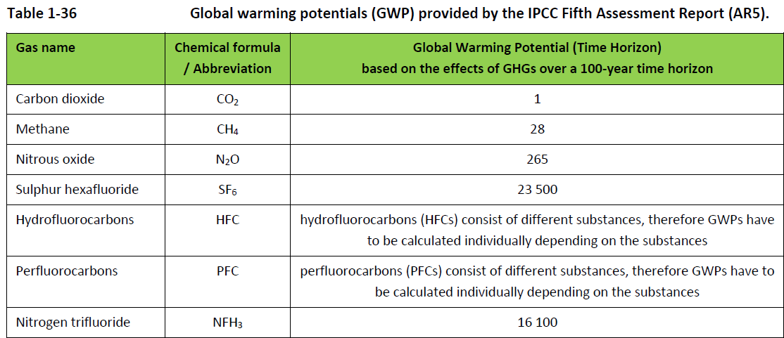
MPGs: GHG-I (chap. II)
D - Metrics (§ 37)
Each Party shall use the 100-year time-horizon global warming potential (GWP)
values from the IPCC Fifth Assessment Report, or 100-year time-horizon GWP values from
a subsequent IPCC assessment report as agreed upon by the CMA, to report aggregate
emissions and removals of GHGs, expressed in CO2 eq …
AR 5
NF₃

Slide 7
MPGs: GHG-I (chap. II)
E – Reporting guidance (§ 38-58)
The national inventory report consists of a national inventory document (NID) and the common reporting tables (CRT).
Each Party shall report the information:
Information on methods and cross-cutting elements
Sectors and gases
Time series

Slide 8
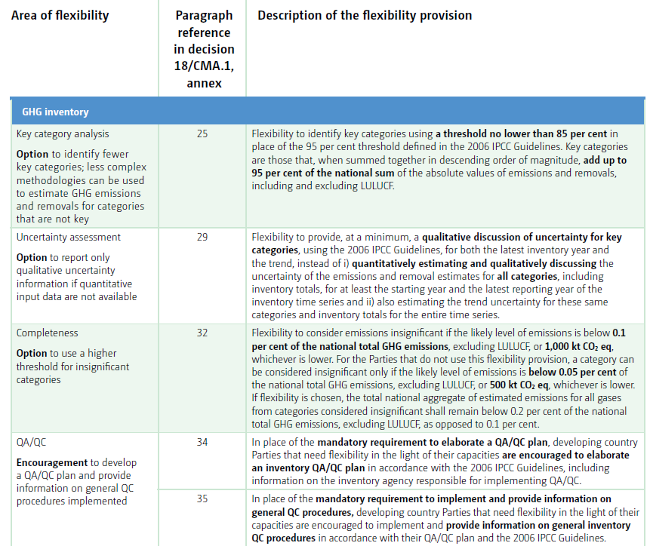
MPGs: GHG-I (chap. II, flexibility)
Flexibility provisions as described in chapter II from Decision 18 / CMA.1 Annex

Slide 9
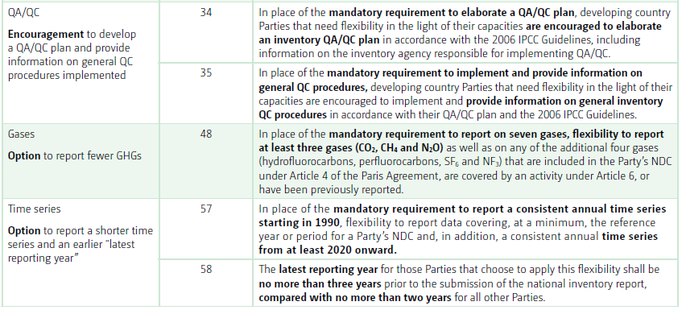
MPGs: GHG-I (flexibility, chap. II)
Flexibility provisions as described in chapter II from Decision 18 / CMA.1 Annex

Slide 10
MPGs: flexibility II
Reporting elements | ‘Shall’ provision in MPGs | Flexibilities applicable
Key category analysis | 95% threshold | 85% to 95% threshold
Uncertainty assessment | Quantitative and qualitative for all categories | At least qualitative uncertainty assessment
Insignificance threshold | ‘NE’ if lower than 0.05% of NT and 500Kt of CO₂e | ‘NE’ if lower than 0.1% of NT and 1000Kt of CO₂e
QA/QC | Develop QA/QC Plan | Encouraged to develop
QA/QC | Implement general QC procedures | Encouraged to implement
Greenhouse gases | CO₂, CH₄, N₂O, HFCs, PFCs, SF₆ and NF₃ | CO₂, CH₄, N₂O. Other if in NDC or reported before
Time series | T-2 timeliness | T-3 timeliness
Time series (can be challenging) | Annually between 1990 and t-2 | Reference year for NDC, and annually from 2020 to t-3
Summary
Flexibility to developing country Parties that need it in light of their capacities

Slide 11
Some focus on Guidelines & Good practices

Slide 12
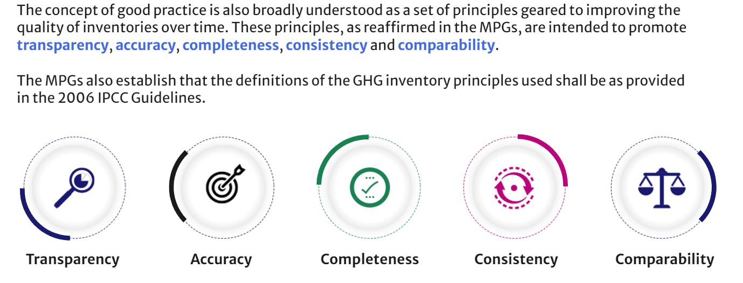
Good practice – TACCC principles
A sustainable and robust system consists of five basic principles: TACCCs

Slide 13
Good practice – TACCC principles
Transparency means that the assumptions and methodologies used for an inventory should be clearly explained to facilitate replication and assessment of the inventory by users of the reported information.
Accuracy is a relative measure of the exactness of an emission or removal estimate. Estimates should be accurate in the sense that they are systematically neither over nor under true emissions or removals, as far as can be judged, and that uncertainties are reduced as far as practicable.

Slide 14
Good practice – TACCC principles
Completeness means that an annual inventory covers at least all sources, as well as all pollutants, for which methodologies are provided in the agreed methodology Guidelines. Completeness also means the full geographical coverage of the sources of a Party.
Consistency means that an annual inventory should be internally consistent for all reported years in all its elements across sectors, categories and pollutants. An inventory is consistent if the same methodologies are used for all years of the inventory and if consistent data sets are used to estimate emissions.

Slide 15
Good practice – TACCC principles
Comparability means that estimates of emissions and removals reported by Parties in inventories should be comparable among Parties. For this purpose, Parties should use the agreed methodologies and formats.

Slide 16


Focus on – Assessment of completeness and transparency
Respect for confidentiality
certain information collected during the production of the inventory is likely to be confidential. Confidentiality should be managed in such a way as to respect the corresponding constraints.
Punctuality
The inventories transmitted within the framework of international commitments must respect certain deadlines. In the case of the design of an inventory system, this component must be taken into account to put in place the means to meet this objective.

Slide 17
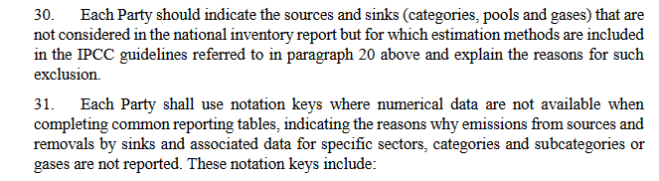
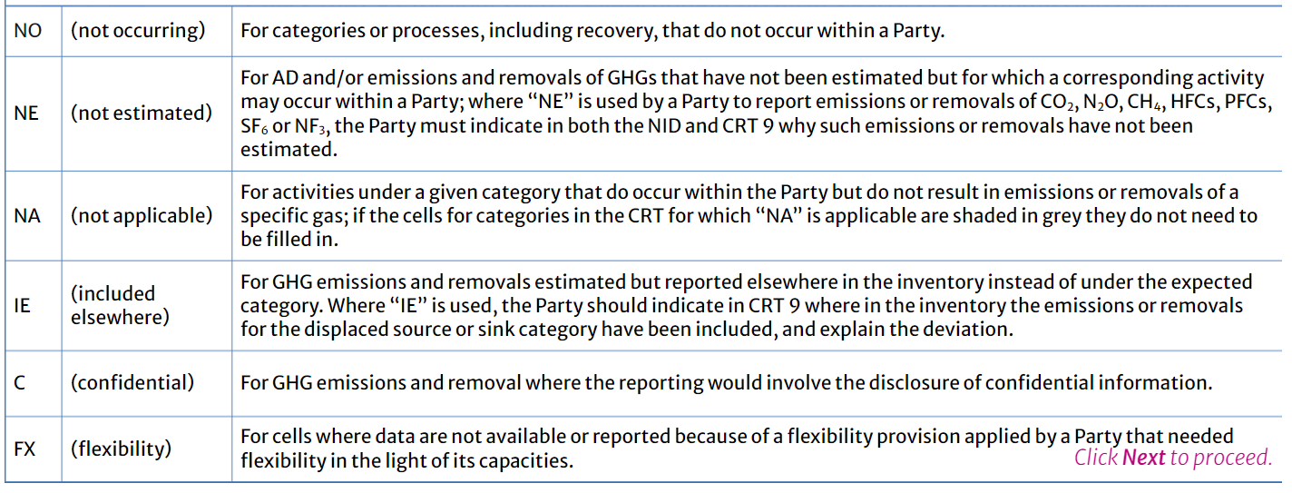
Focus on – Assessment of completeness
Decision 18/CMA.1

Slide 18
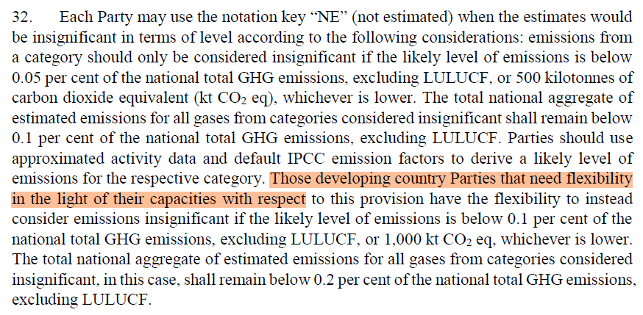
Focus on – Assessment of completeness
Decision 18/CMA.1

Slide 19
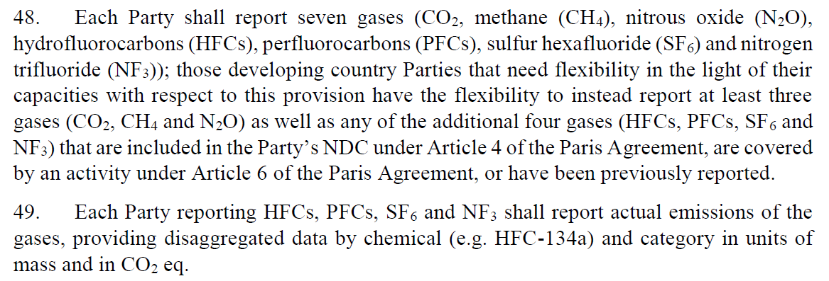
Guidelines on reporting
Decision 18/CMA.1

Slide 20
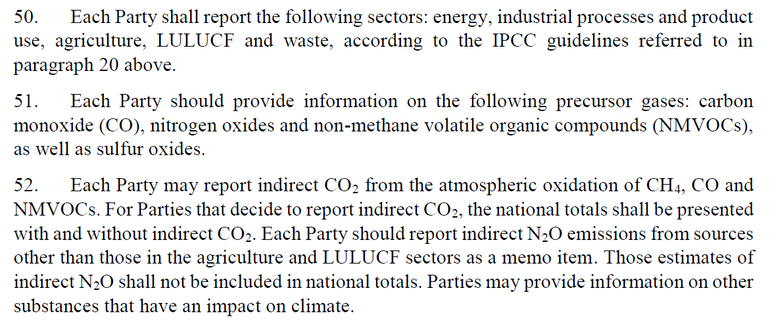
Guidelines on reporting
Decision 18/CMA.1

Slide 21
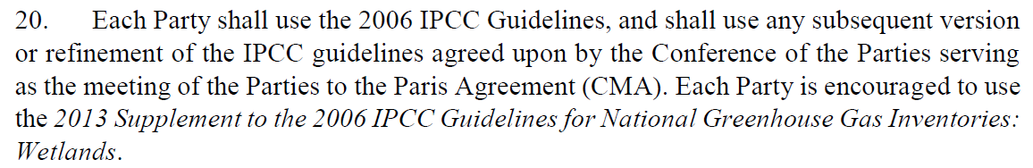
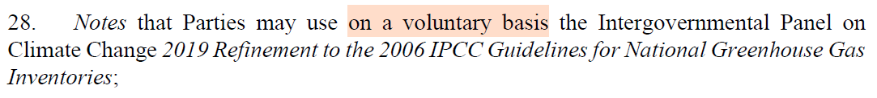
Methodological Guidelines to be used
Decision 18/CMA.1
Decision 5/CMA.3

Slide 22

Key categories / Key Category Analysis
Categories are considered key if they have a significant influence on a country’s total GHG inventory in terms of:
Absolute level of emissions and removals;
Trend in emissions and removals;
Uncertainty of emissions and removals.
To identify key categories, Parties need to perform a key category analysis.

Slide 23
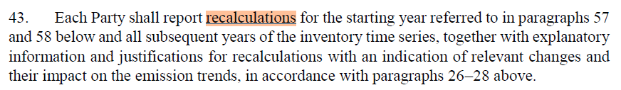
Time series consistency and recalculations
Decision 18/CMA.1
Starting in the 2025 submission for Paris Agreement period
(to be compared with fist BTR 2024 inventory)

Slide 24
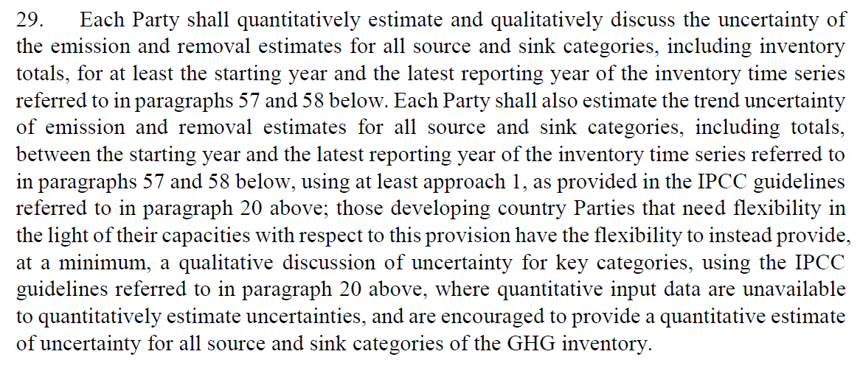
Uncertainties
Decision 18/CMA.1

Slide 25
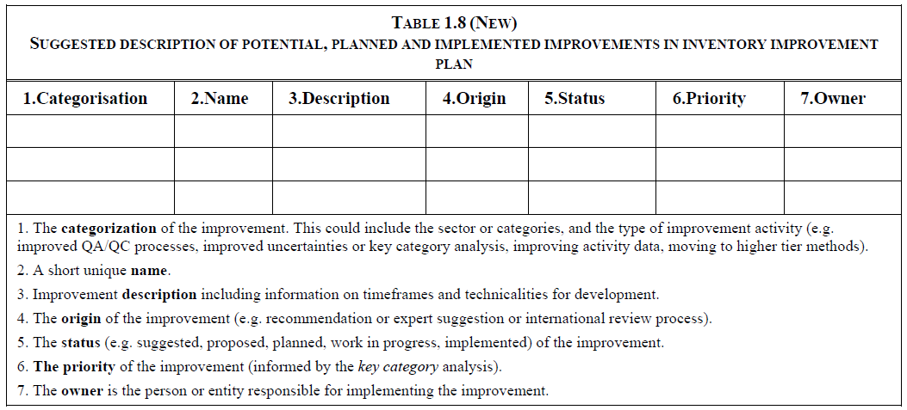
Improvement plan
IPCC 2019

Slide 26
Improvement plan
Example of general possible improvements to be planned
Institutional and Procedural/technical Improvements
GHG emissions and removals could be enhanced through institutional and procedural / technical improvements to be planned for next inventory submissions, e.g. :
. Enhancing the national inventory system, the data management system, the archiving and the documentation of the GHG inventory, in order to improve transparency and traceability.
. Enhancing the level of capacity of national experts and institutions involved in the compilation of the national GHG inventory (trainings, international supports…).
. Improving the methodologies for the Key Categories, e.g. shifting from default emission factors and Tier 1 to country-specific emission factors and Tiers 2 / 3 methodologies.
.Etc.

Slide 27
Good practices
CRT Common Reporting Tables

Slide 28
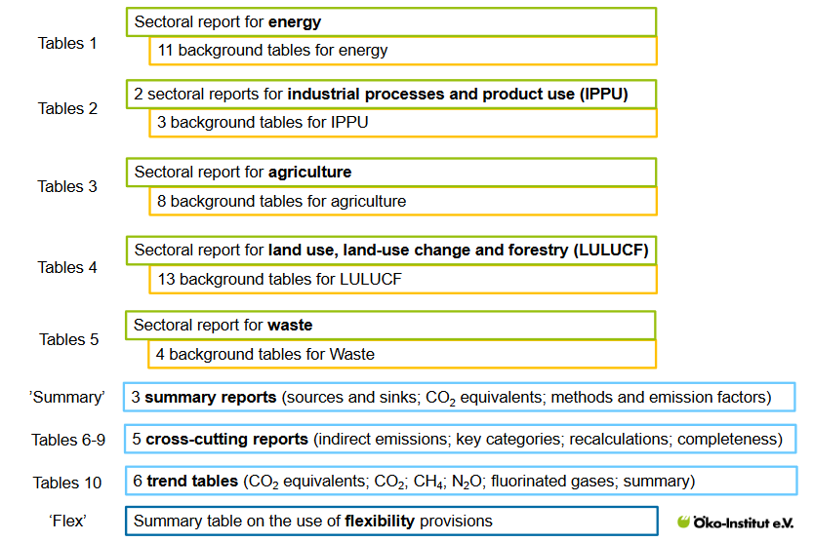
Common Reporting Tables (CRT)
60 tables

Slide 29
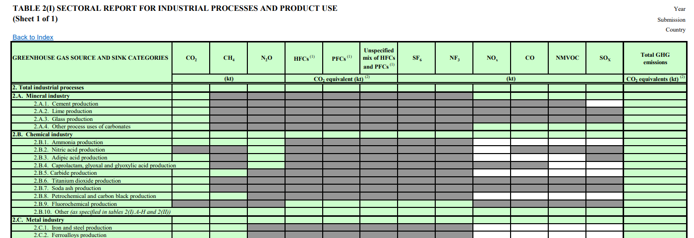
Common Reporting Tables – CRT
CRTs are standardized set of reporting tables that all Parties must submit under the reporting requirements of the MPGs.
Parties prepare the CRTs using a reporting tool - CRT Reporting software
Developing country Parties that need flexibility in the light of their capacities may collapse relevant row(s), column(s) and/or table(s) in cases where they have applied flexibility
Example of CRT table↓

Slide 30
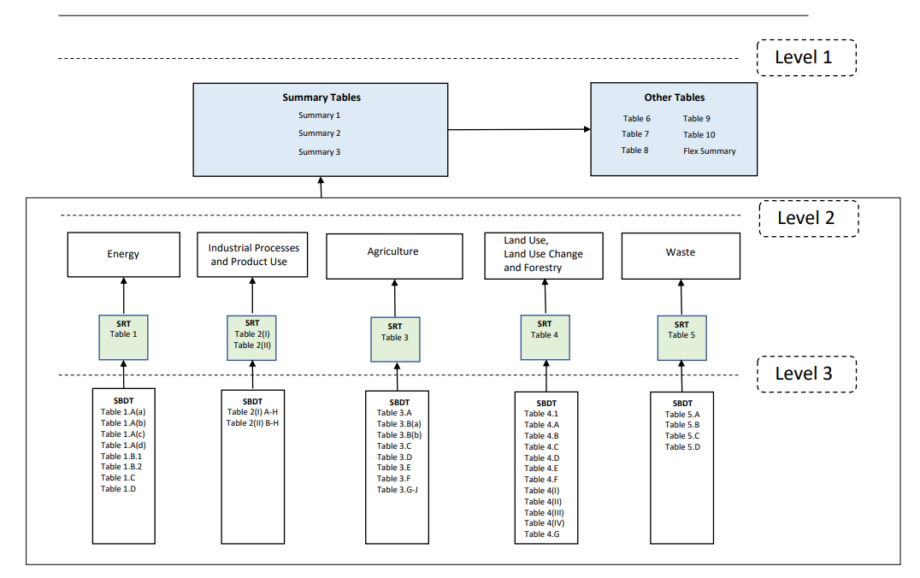
Common Reporting Tables – CRT
The CRTs can be split into 3 different levels of aggregation:
1. National summary reports and cross-cutting information tables
2. Sectoral reporting tables
3. Background data tables (transparency)

Slide 31
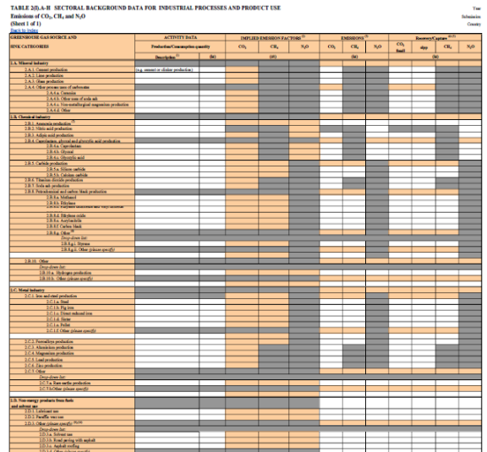
CRT – Level 3: Sectoral background data
Require detailed information on emissions, removals, AD and other relevant information at the category and subcategory level.
Most of the data in the sectoral background tables are filled in by the inventory compiler.
Cells in which emissions are summed at the category level, along with IEFs or implied carbon stock change factors. are automatically calculated by the CRT software

Slide 32
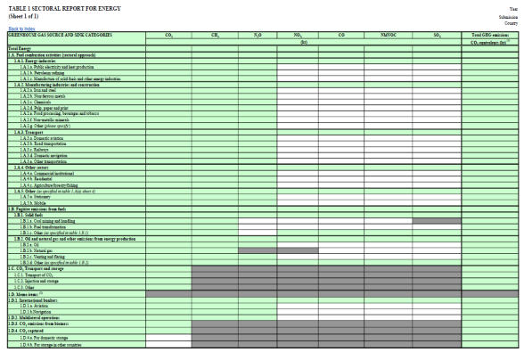
CRT – Level 2: Sectoral reporting data
Level 2 CRTs essentially aggregate the data from the sectoral background data tables at the sectoral level. There is one level 2 table for each sector
Most of the data are automatically calculated by the reporting software tool based on the data provided in the background data tables (level 3).

Slide 33
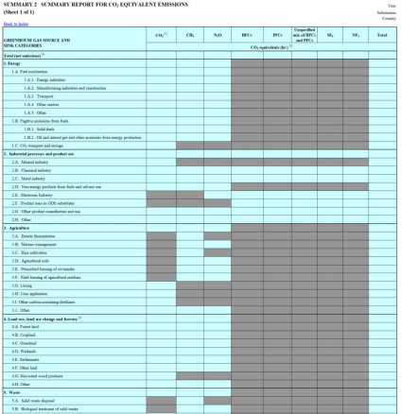
CRT – Level 1: Summary and cross-cutting data
Summary 1: summary report of total emissions by sector and category
Summary 2: summary report for CO₂ eq emissions;
Summary 3: summary report for methods and EFs that the Party used for its estimates
Other summary and cross-cutting tables
Table 6: indirect emissions of N₂O and CO₂;
Table 7: key categories;
Table 8: recalculations in the Party’s inventory relative to its previous submission;
Table 9: categories or subcategories that were not estimated, including the reasons, or reported elsewhere, including a reference to where the emissions were reported.
Table 10: summary of emission trends over the entire time series (e.g. 1990–2022).

Slide 34
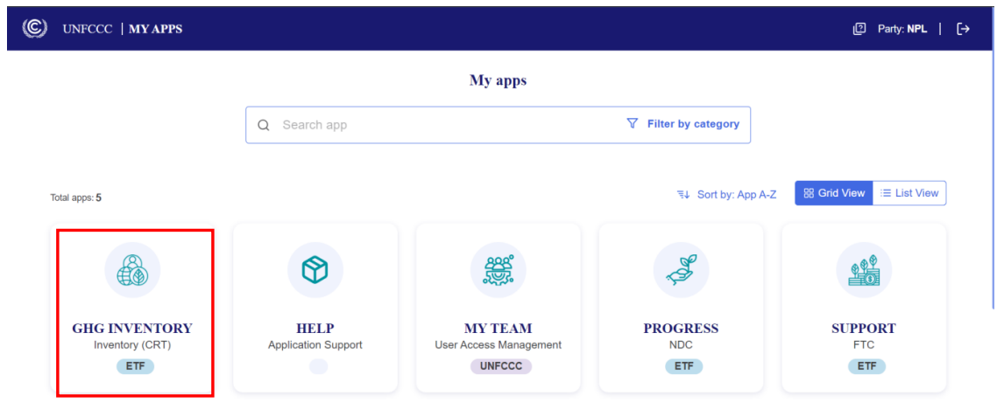
Accessing the Reporting Tool
Users can access the reporting tools at UNFCCC My Apps (https://myapps.unfccc.int).

Slide 35
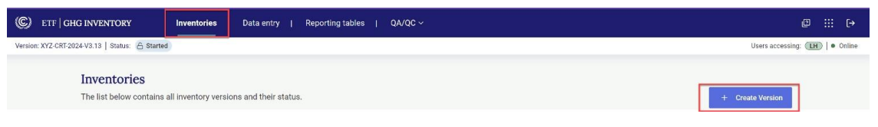
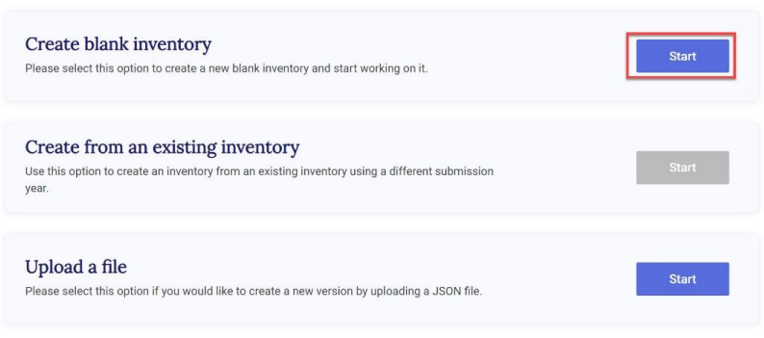
(1) Create an inventory version
• In the inventories tab, select “+ Create version”
• Then select “Create blank inventory” – the most relevant solution when preparing a first GHG Inventory

Slide 36
(1) Inventory versions – Specification of settings
• Once the version is created, the user must specify the following information. It will influence on the automatic filling of the tables and how the tables are structured:
Submission year and flag for the default version
Flexibility provisions (Yes / No)
Sector-related settings
Energy (optional):
Calorific value for fuels in category 1A (either NCV or GCV)
Specify fuel(s) that are not occurring (“NO”)
IPPU (optional):
F-Gas(es) that are not occurring (“NO”)
Agriculture (mandatory)
Cattle categorization
LULUCF
Approach for HWP (default options pre-selected; may change)
Reporting information
You can edit these settings later, even when data has already been filled in the inventory
Notes:
Option A: Select this option for cattle categorization as “Dairy cattle” and “Non-dairy cattle.”
Option B: Select this option for country-specific cattle categorization as “Mature dairy cattle,” “Other mature cattle,” “Growing cattle,” and “Other (please specify).”
Approach A: Stock change approach.
Approach B: Production approach.
Approach B1: Aggregate for consumed domestically and exported.
Approach B2: Separate for consumed domestically and exported.
Approach C: Atmospheric flow approach.

Slide 37
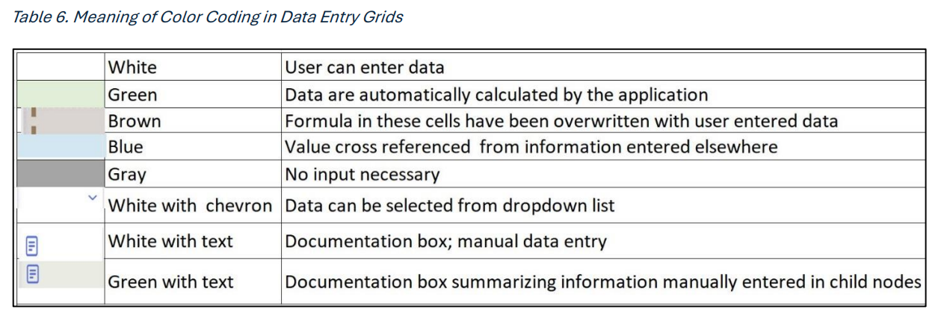
(2) Data entry – Colour code in the Data Entry Grid
Colour code:
→ Colored cells are automatically completed by the software when Parties submit their data
→ Grey shaded cells should not be filled
→ White cells must be filled by the Party. Parties are required to use the standard notation keys « NO », « NE », « NA », « IE », « C », « FX », where no numerical values are available – to ensure that their inventories are complete,

Slide 38
(2) Data entry – How to enter data
Manual input into the data entry grids in the application.
Export and import of data using Excel.
Export and import of data using .json (for connecting with a national system or interoperability with the IPCC tool).
Beware when importing .json file from the IPCC tool: IPCC tool does not accept the notation keys.
→ NK should be filled separately in addition

Slide 39
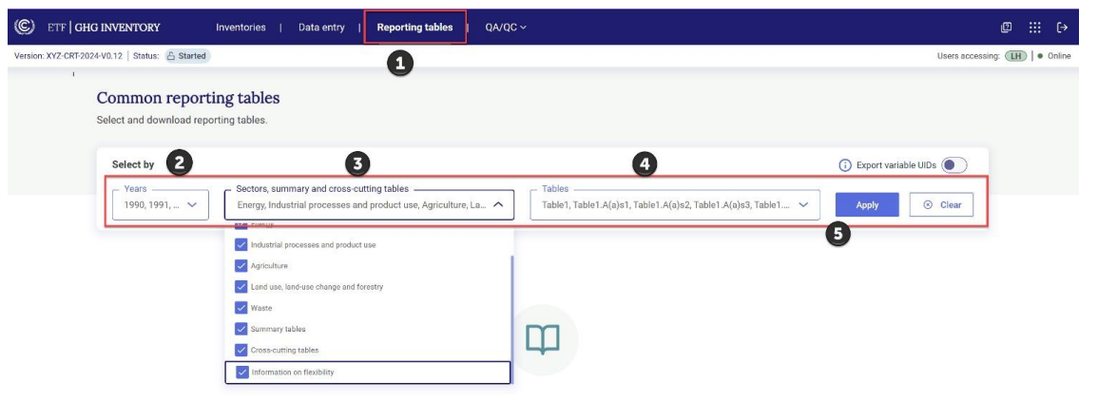
(3) Generate CRT tables
The user may generate a single reporting table, multiple reporting tables or the entire GHG inventory CRT tables for one or more years.
Notes:
To generate the common reporting tables
Select Reporting tables from the Header bar.
Select the Year(s) of interest by checking the corresponding box(es) before the year(s).
Select which sectors, summary and/or cross-cutting tables to generate by checking the box(es) under Sectors, Summary and Cross-cutting table(s).
User can also select the specific Tables to generate. By default, the dropdown will identify all tables for download that meet the criteria in Sectors, summary and crosscutting tables.
Select Apply

Slide 40
NID: National inventory document

Slide 41



NIR – Overview
CRTs
Quantitative information on emissions and removals in a common format
NID
Comprehensive and detailed information on how emissions and removals were estimated.
Complementarity
Under UNFCCC, the NID can be submitted as part of the BTR or as a stand-alone report.
Under the Energy Community, the NID is submitted as a stand-alone document.
Common outline and structure that is provided in annex V to decision 5/CMA.3

Slide 42
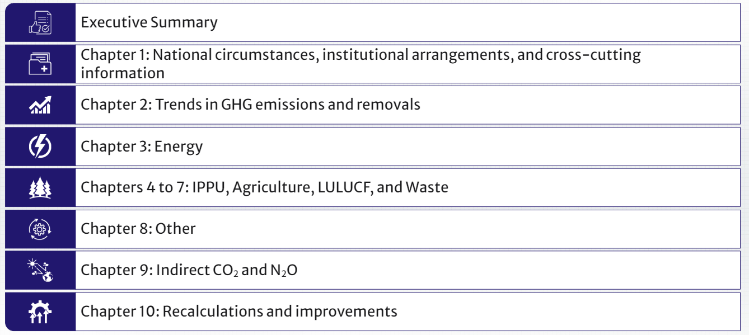
NID Outline
Outline not mandatory but encouraged for use
i

Slide 43
NID Outline
This section includes an overall summary of the national emissions and removals and trends, the key categories in the country, national circumstances affecting emissions and key improvement

Slide 44
NID Outline
This section includes a discussion on major drivers of climate in the country (e.g. weather, economy), the processes established to prepare the GHG inventory and an overview of cross-cutting information (e.g. methodological tiers used, key categories, QA/QC processes and plan, overview of uncertainty assessment, general assessment of completeness and the metrics used). This section also includes a summary of flexibilities applied.

Slide 45
NID Outline
This section provides an overview of GHG emissions and removals by total national level, by sector and by gas.

Slide 46
NID Outline
This section presents a disaggregated outline to be used for the energy sector only.
Parties may elect to use the same less detailed outline used for the other sectors
(presented in chaps. 4–7 of the NID). The more detailed outline includes an
overview of the sector, and then separate detailed descriptions for fuel
combustion, fugitive emissions and CO₂ transport and storage. For each of these
three broad categories the outline includes a description of the category,
methodological issues, description of flexibility, uncertainty assessment, category specific QA/QC, recalculations and planned improvements. In addition, there is a section on the reference approach, international bunkers and feedstocks.

Slide 47
NID Outline
For each sector, the same general outline applies, covering, for each category, a description of the category, methodological issues, description of any flexibility applied, uncertainty assessment, category-specific QA/QC, recalculations and planned improvements. In practice, Parties may include this discussion at different levels of aggregation, depending on the approach, methods used and institutional arrangements in the country.

Slide 48
NID Outline
This section is not elaborated in the outline and few countries report emissions/removals here. One might expect that, if reported, this section would be organized in a similar, but likely less detailed manner than chapters 3–7 of the NID

Slide 49
NID Outline
This section includes a description of the indirect emissions considered in the inventory, including methodological issues, uncertainty assessment, QA/QC, recalculations and planned improvements

Slide 50
NID Outline
This section explains the overall impact of the recalculations in the inventory, including those made in response to the review process. It looks at reasons for the recalculations, the quantitative impact on trends, and planned areas of improvements.

Slide 51
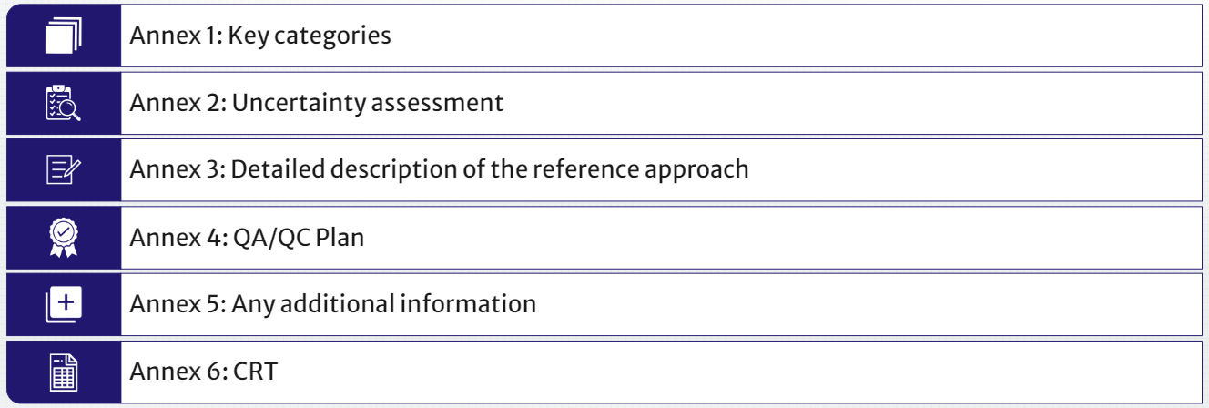
NID Outline

Slide 52
NID Outline
This section is used to present the different key category analysis : in absolute level of emissions and removals, in trend of emissions and removals, and, key category analysis combined with uncertainty of emissions and removals.

Slide 53
NID Outline
This section would highlight the country’s uncertainty analysis, including the methodology used and the results.

Slide 54
NID Outline
This section would highlight the country’s reference approach, including inputs and how the results compare with emission estimates calculated using the sectoral approach.

Slide 55
NID Outline
This section could contain the QA/QC plan developed by the Party. Remember that developing countries that need flexibility in light of their capacities with respect to the provision on elaboration of a QA/QC plan are encouraged but not required to provide such a plan.

Slide 56
NID Outline
This section provides space for the inclusion of any additional information, as applicable, including e.g. more detailed methodological description of categories and on national energy balance

Slide 57
NID Outline
Some Parties attach their CRTs to the NID submission or provide a link to the CRTs, but this is not necessary. The CRTs will also be available on the UNFCCC website.

Slide 58
NID - Transparency on methodologies
Methodologies used to estimate emissions and removals of GHGs from all sources and sinks must be transparently documented in the NID, including the rationale for their selection.
Clear reference to the methods is needed, description of the methodologies contained in the 2006 IPCC Guidelines need not be duplicated in the NID.
The reporting of transparent information on the higher-tier methods and models used is particularly important for Key category sources.
Where the Parties use country-specific methodologies to better reflect their national situation, they must show that these are compatible with the 2006 IPCC Guidelines and are well documented and scientifically based.

Slide 59

Thank you
Jean-pierre.chang@citepa.org
Julien.vincent@citepa.org
42 rue de Paradis 75010 Paris
01 44 83 68 83
infos@citepa.org
citepa.org

